Slide 1
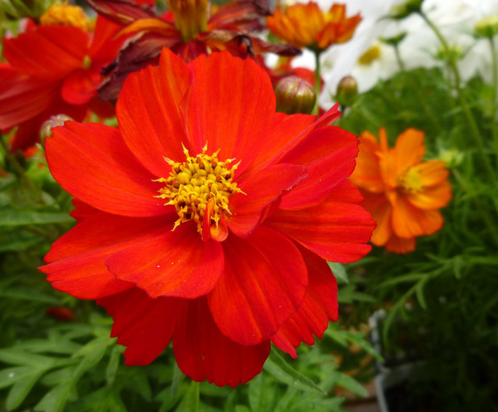
CHELSEA GARDEN CLUB cgc.nyc@gmail.com

Slide 2
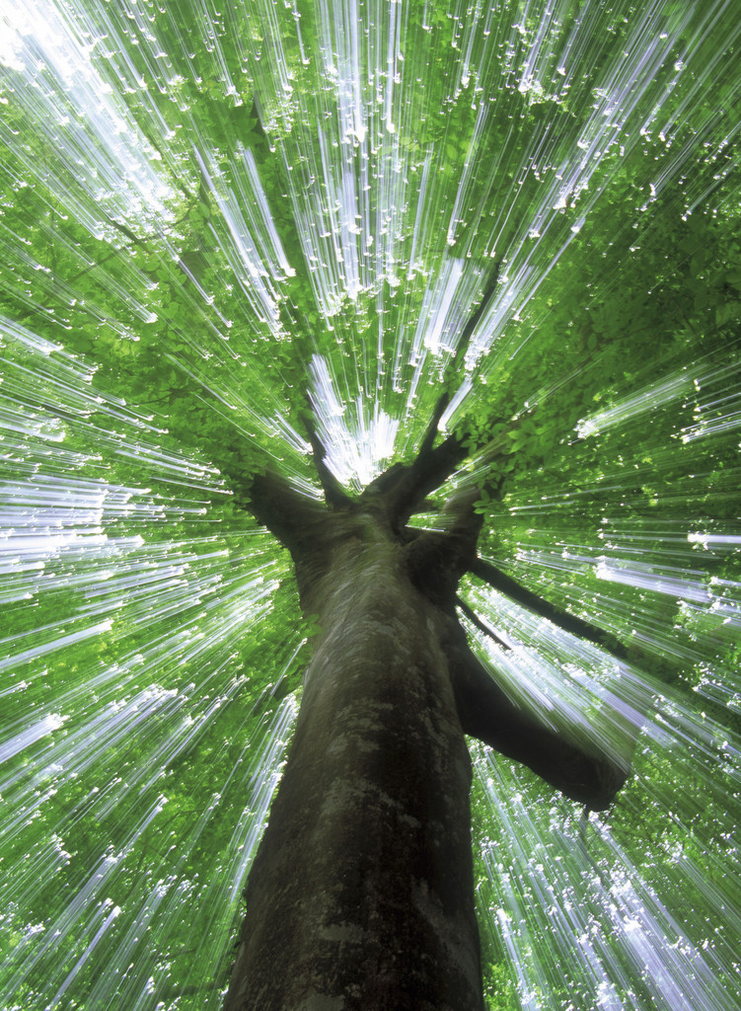
How We Got Started
NYC created 9th Avenue bike lane tree pits
Local volunteers get involved
A critical event happens—destruction of tree pit plantings
Senator Tom Duane’s office gets involved
Volunteers organize the Chelsea Garden Club
Agreement with City agencies

Slide 3
Mission Statement
Flower Power! We are neighbors who are interested in bringing some botanical beauty to the bike-lane
tree pits so we have persuaded the city to allow us to garden there unimpeded. Anyone is welcome to
join at any level of involvement. There are no dues and no formal meetings; Just a desire to keep Chelsea
tree-lined and flower-filled. Join us!
Flower Power! We are neighbors who are interested in bringing some botanical beauty to the bike-lane
tree pits so we have persuaded the city to allow us to garden there unimpeded. Anyone is welcome to
join at any level of involvement. There are no dues and no formal meetings; Just a desire to keep Chelsea
tree-lined and flower-filled. Join us!
Flower Power! We are neighbors who are interested in bringing some botanical beauty to the bike-lane
tree pits so we have persuaded the city to allow us to garden there unimpeded. Anyone is welcome to
join at any level of involvement. There are no dues and no formal meetings; Just a desire to keep Chelsea
tree-lined and flower-filled. Join us!
We are neighbors who are interested in bringing some botanical beauty to the bike lane tree pits, so we have persuaded the City to allow us to garden there unimpeded.
Anyone is welcome to join at any level of involvement. There are no dues and no formal meetings. Just a desire to keep Chelsea tree-lined and flower-filled.

Slide 4
Key Ingredients for Success
Dedicated volunteers
One point person
Advocates—TreesNY, Million TreesNYC,
Senator Hoylman’s office, local newspaper
A blog, e-mail address, Facebook (in progress)
Water sources
Sharing ideas and seeds
Celebrate success

Slide 5
Taking Care of a Tree Bed is Easy
SPRING
Prune
Clean & cultivate
Compost
Plant & Mulch
SUMMER
Water
Plant
Prune
Weed
FALL
Water
Prune
Plant bulbs
Mulch
WINTER
Rest

Slide 6
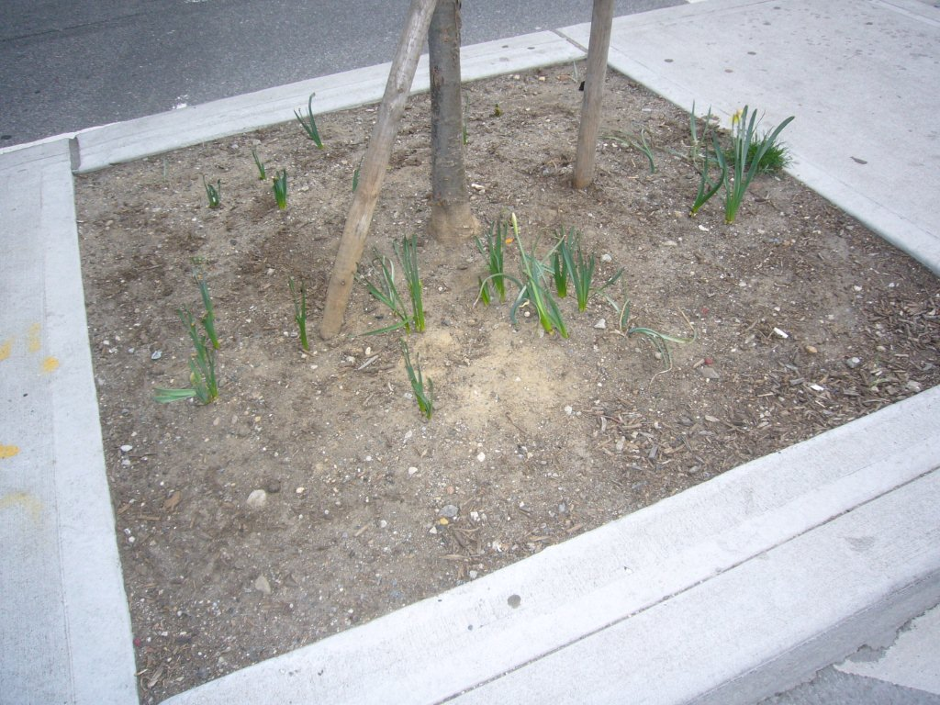
Soil Care
Preparation and Enrichment:
Aerate
Add compost
Mulch
Recycle dead plant material
Don’t add fertilizer or other contaminants

Slide 7
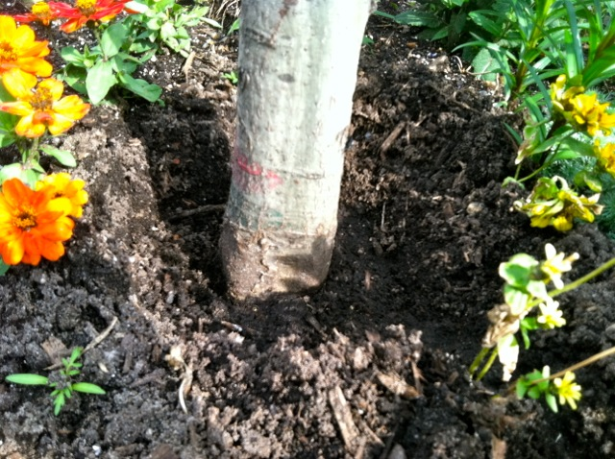
Living Tree Care
Don’t plant around base of tree (15”)
Water tree about 20 gallons a week
Don’t use plants which compete with tree
2-year replacement warranty

Slide 8
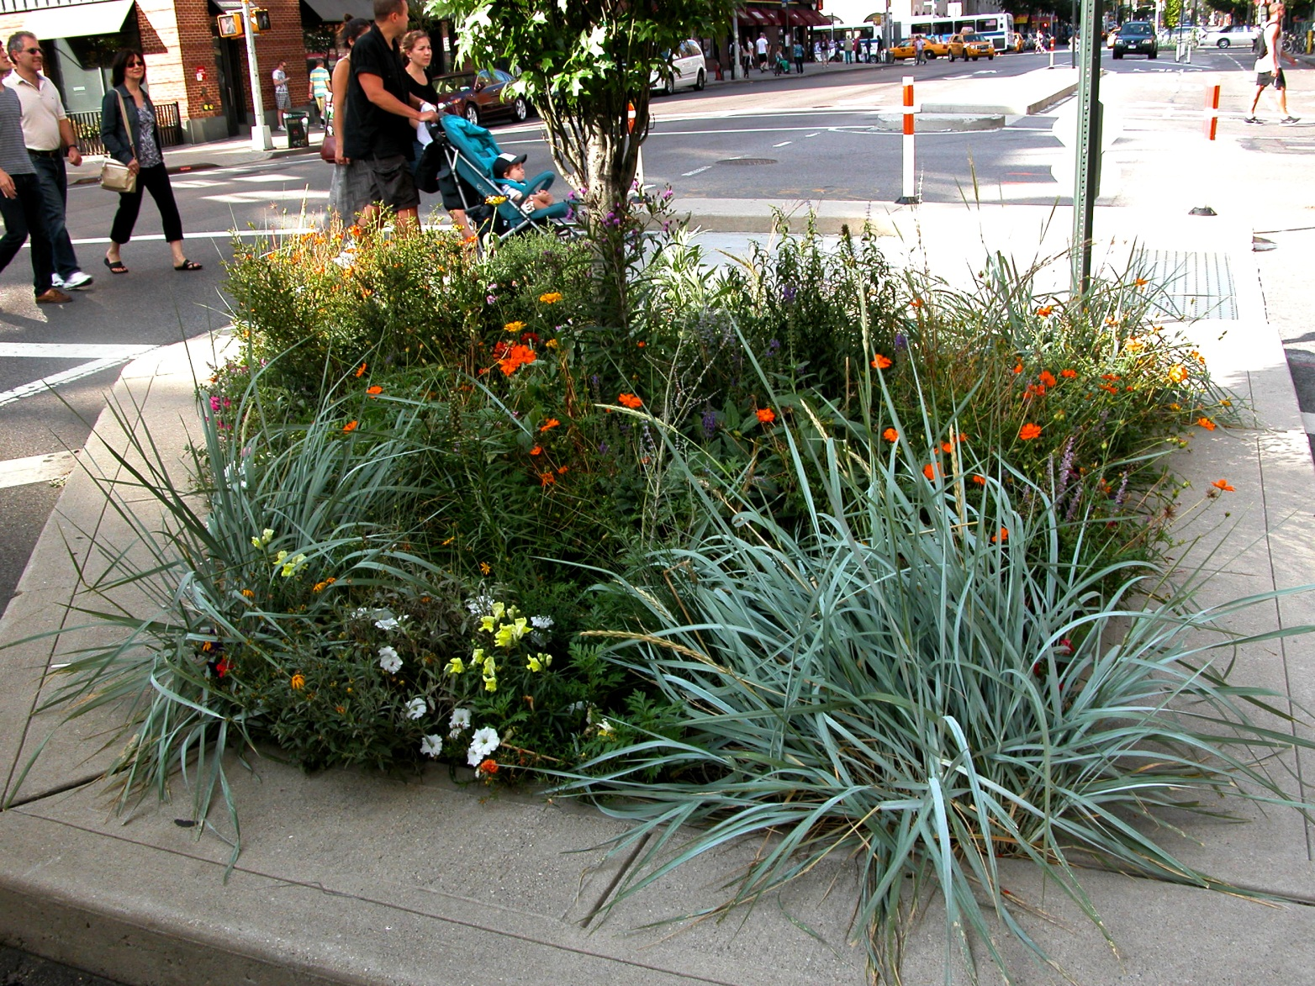
Plant Densely

Slide 9
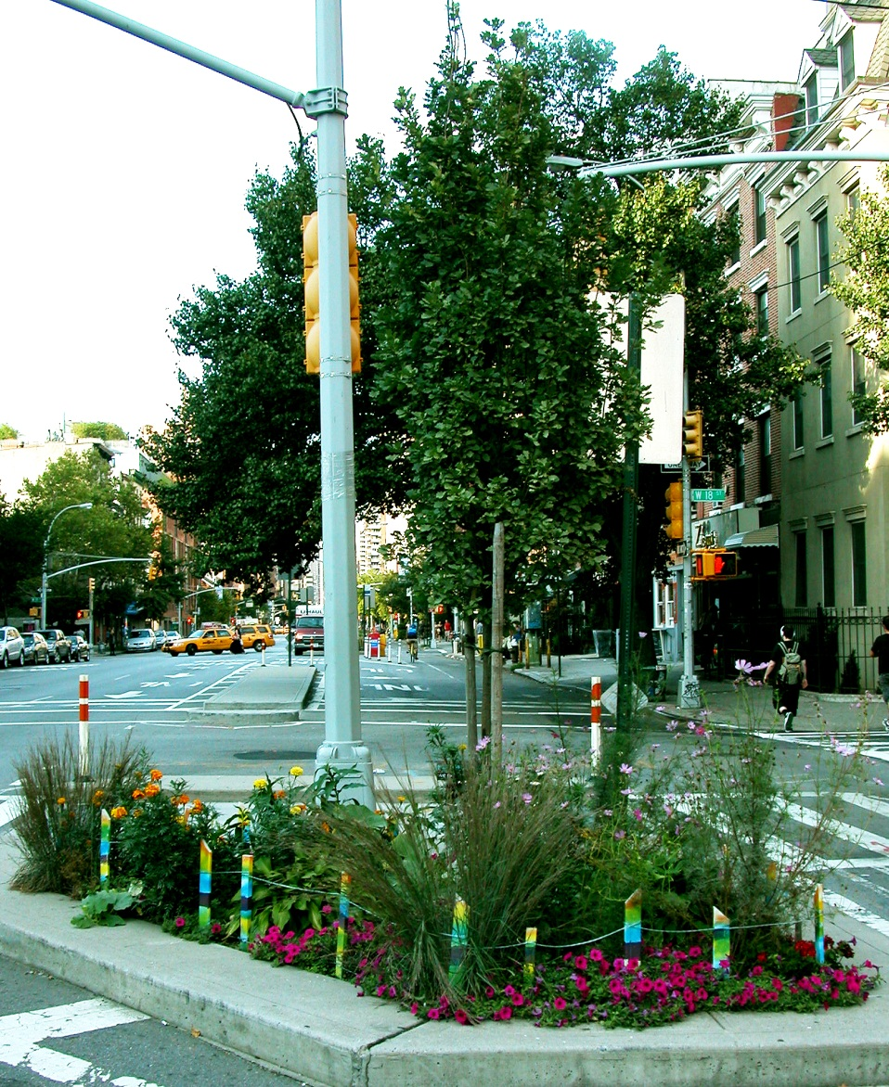
Plant Drought-Resistant Flowers

Slide 10
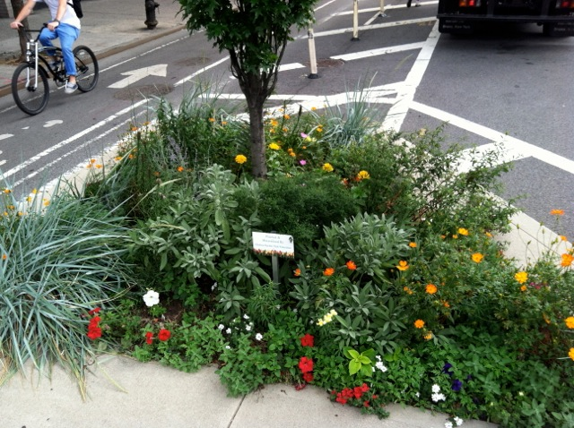
Add Variety

Slide 11
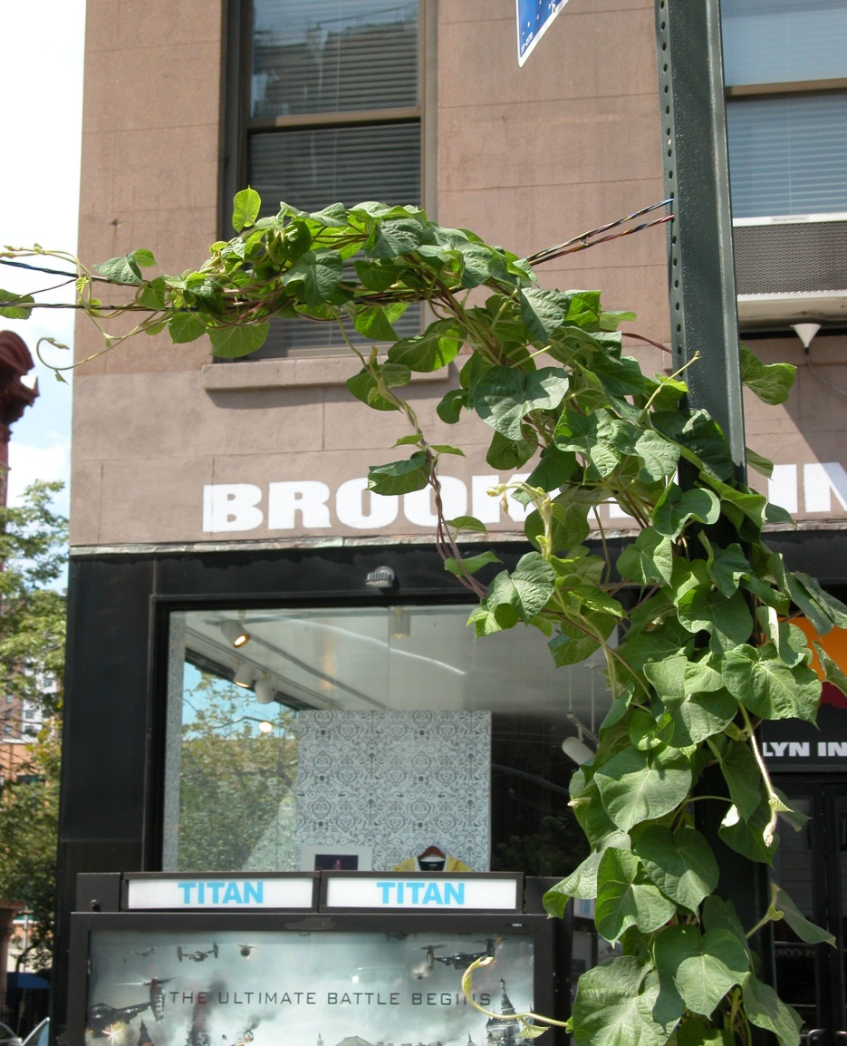
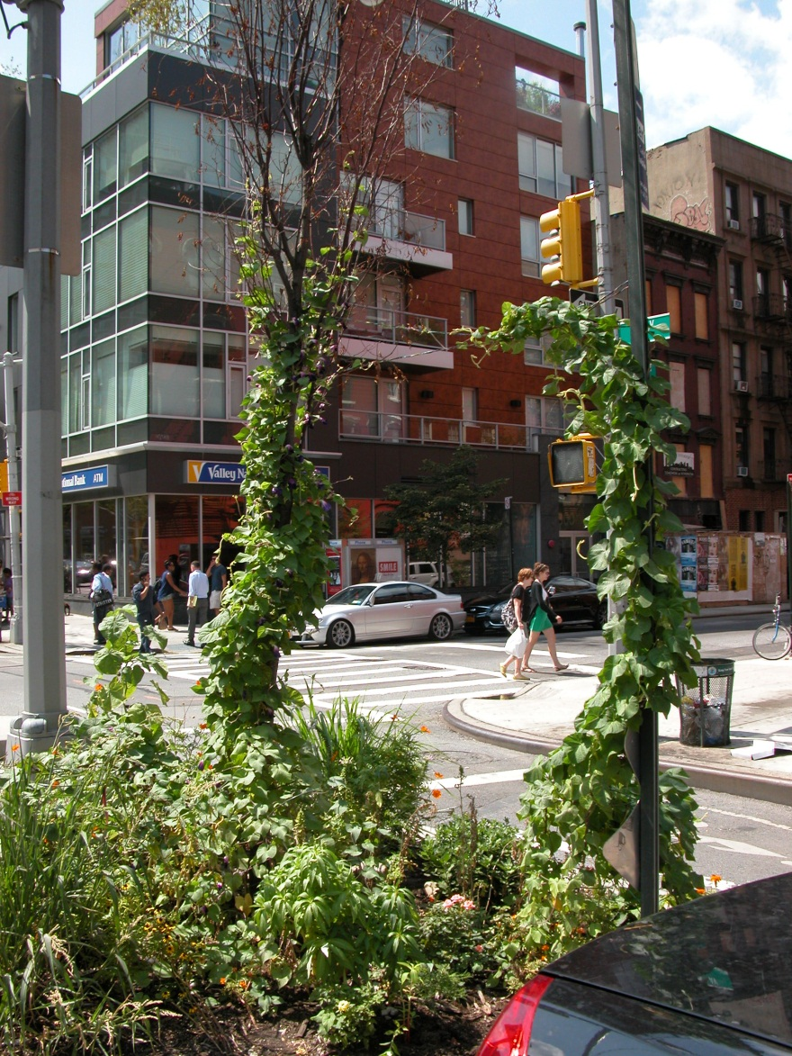
Control Clinging Vines and No Ivy

Slide 12
Key Challenges

Slide 13
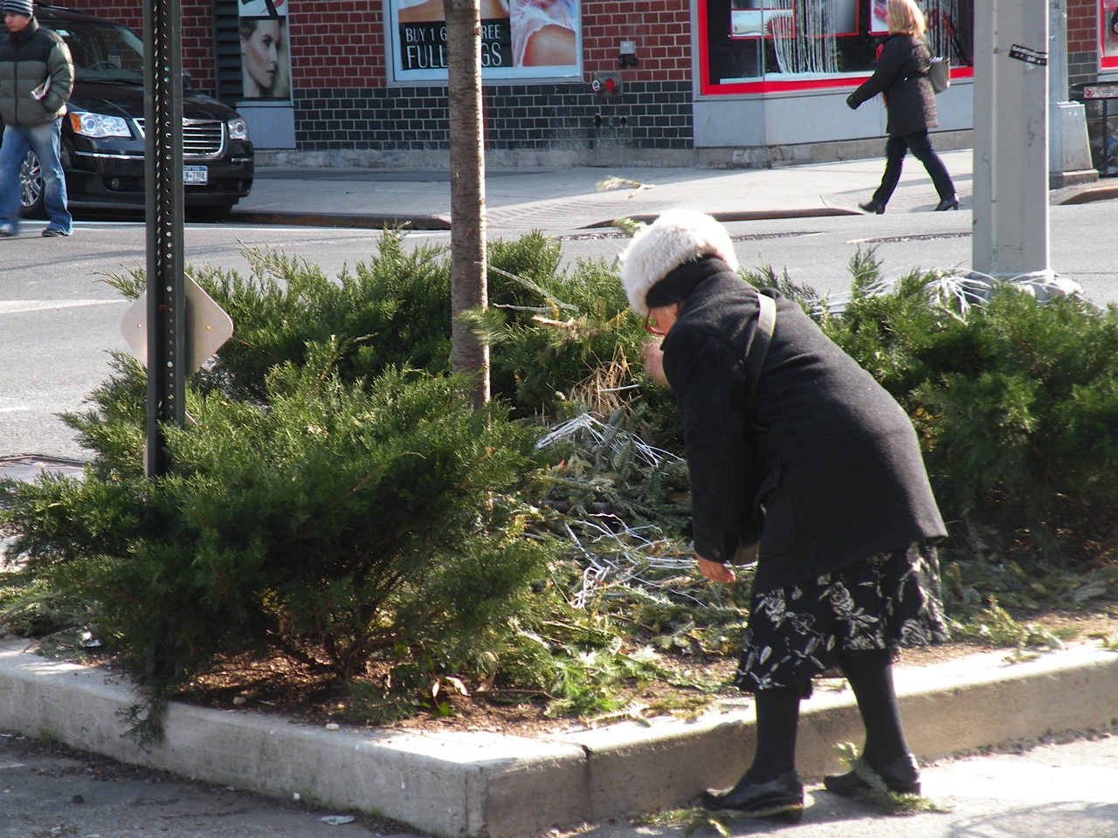
Hazards—Vandalism/Theft

Slide 14
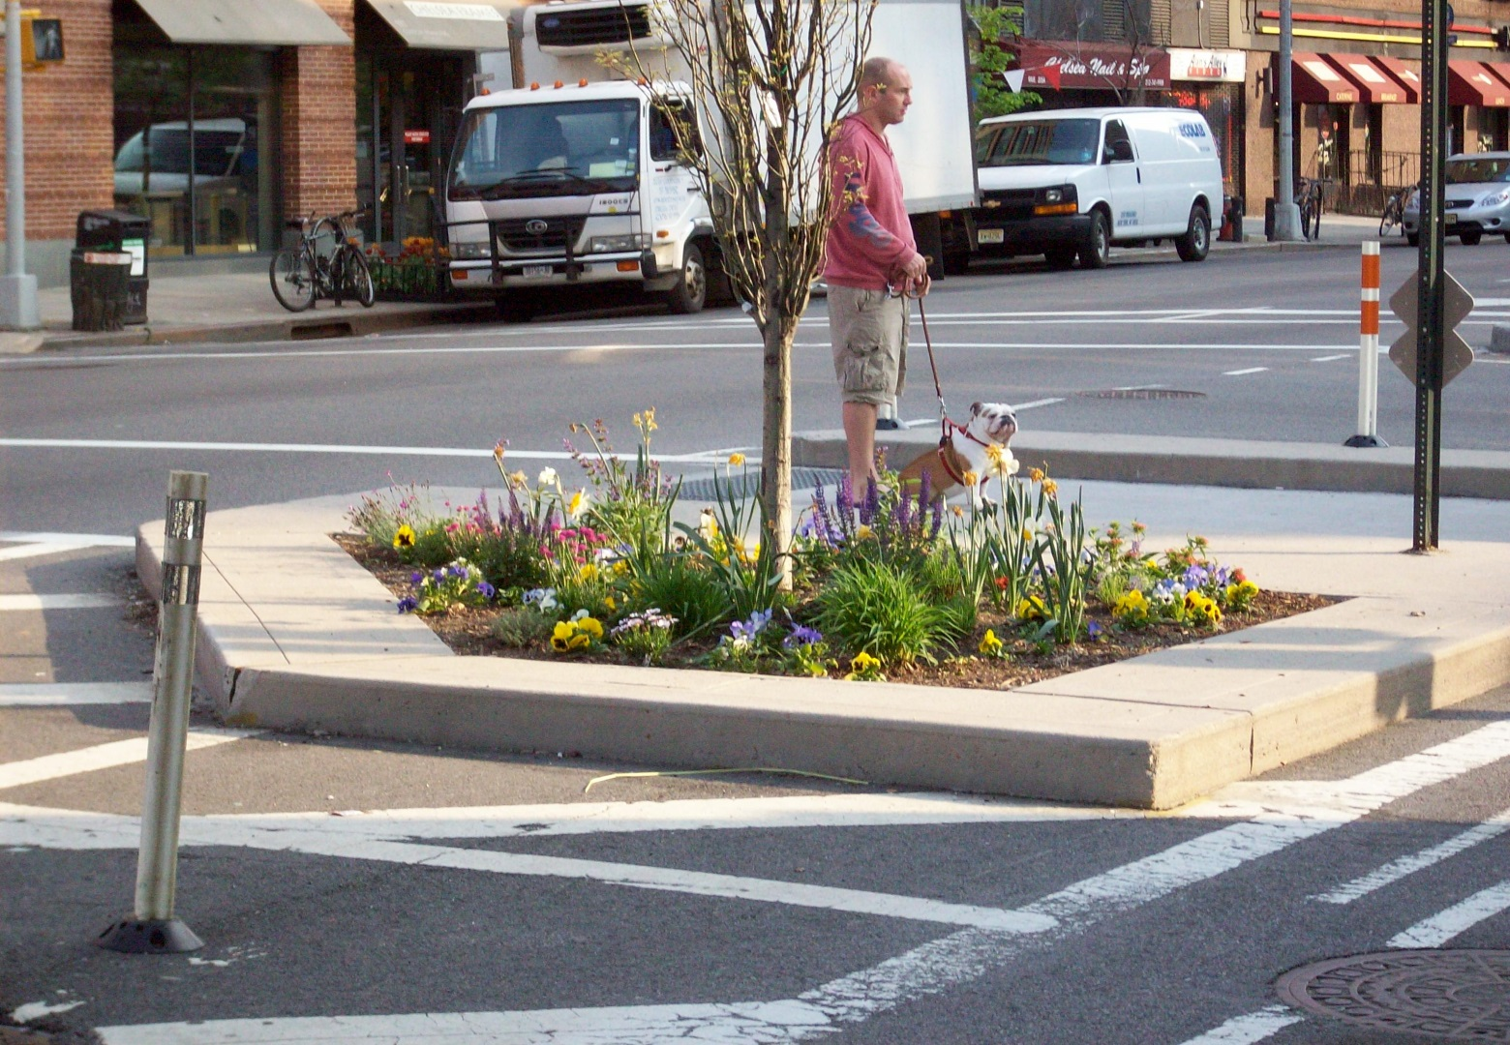
Hazards--Dogs

Slide 15
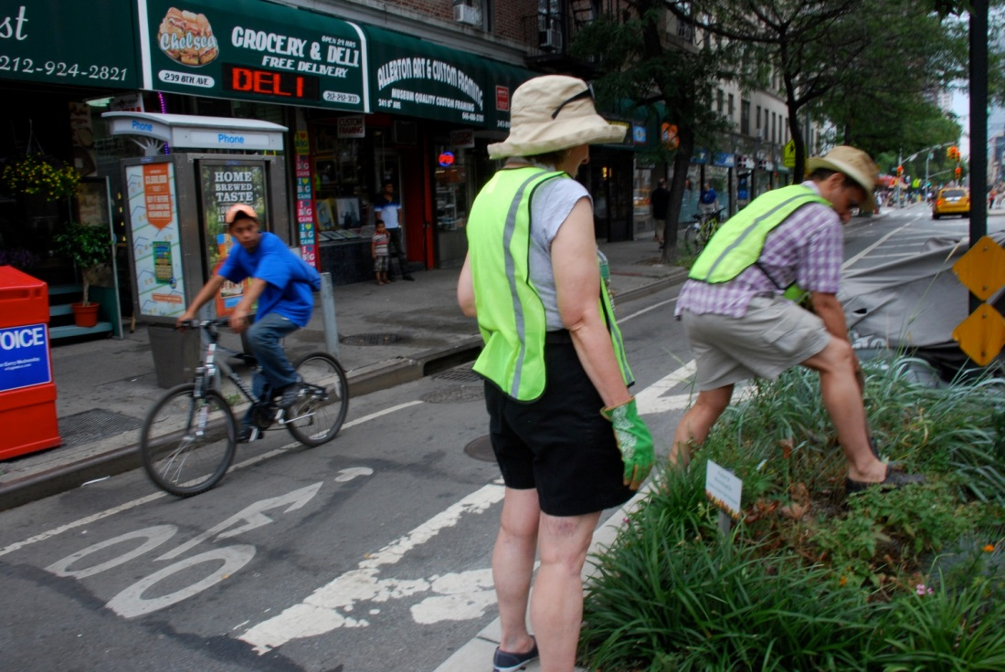
Hazards--Bikes

Slide 16
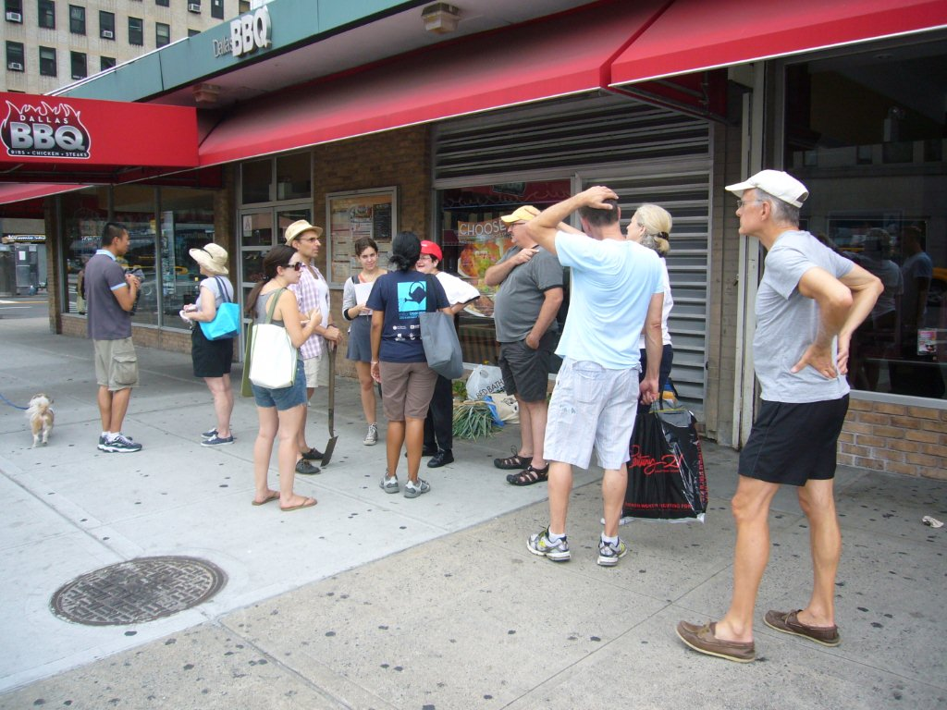
Finding Dedicated Volunteers

Slide 17
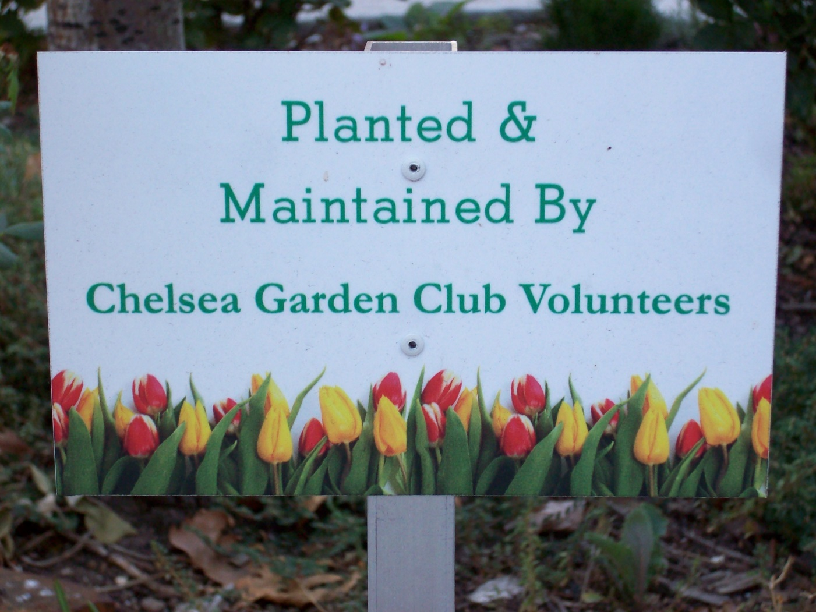
Get a Sign

Slide 18
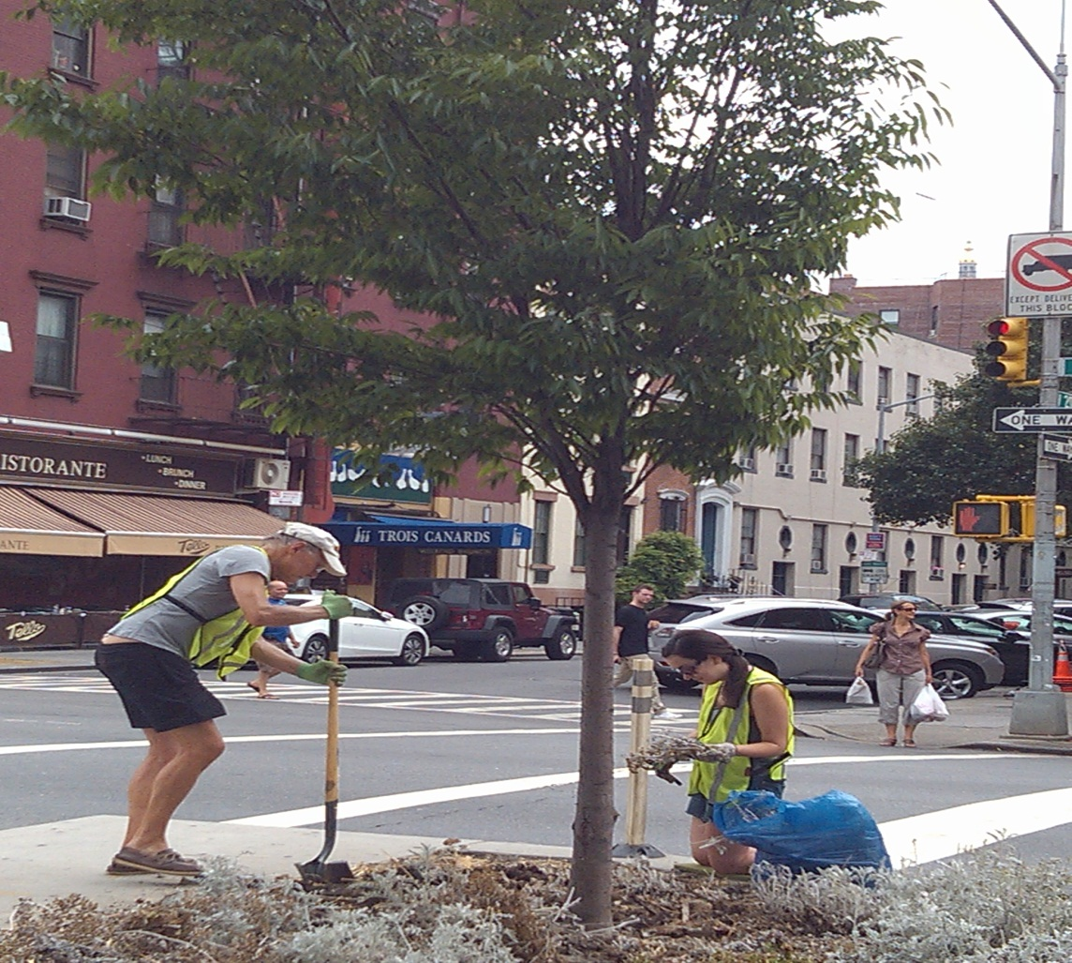
Why Garden
Digging the dirt with
your neighbors is an
engaging outdoor activity
It’s great exercise
Rewarding

Slide 19
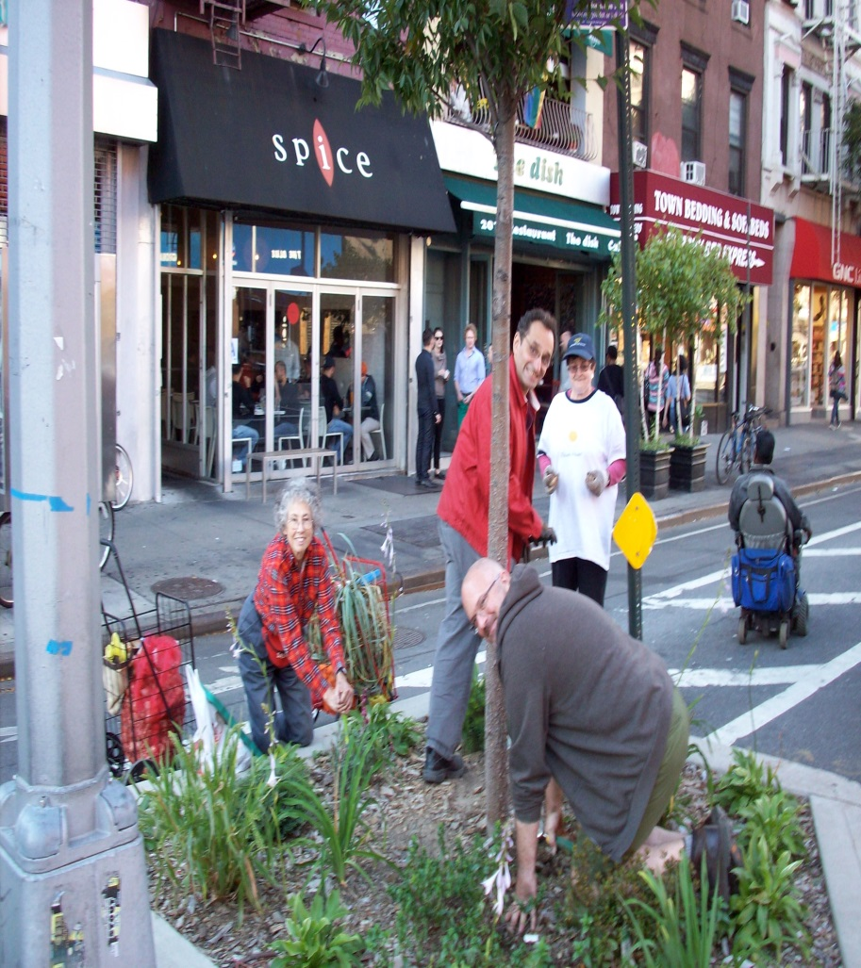
How to Become an Urban Gardener
Adopt a street tree or bike lane tree:
  Go online to http://stewardship.nycparks.org
  Volunteer with the Chelsea Garden Club to maintain bike lane tree beds at cgcnyc@gmail.com, visit our Facebook page or blog at chelseagardenclub.blogspot.com

Slide 20
Available Resources
Million TreesNYC (stewards@milliontreesnyc.org)
Trees New York (info@treesny.org)
Local political leaders
Block Associations and Community Boards
Local newspapers
Sharing learning and information
Chelsea Garden Club

Slide 21
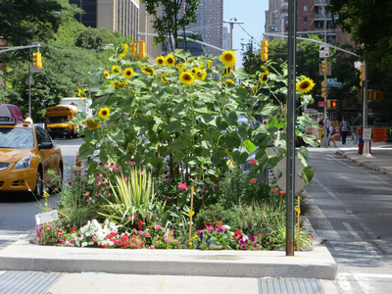
Flower Power!
Thank You

