Slide 1

J-51

Slide 2

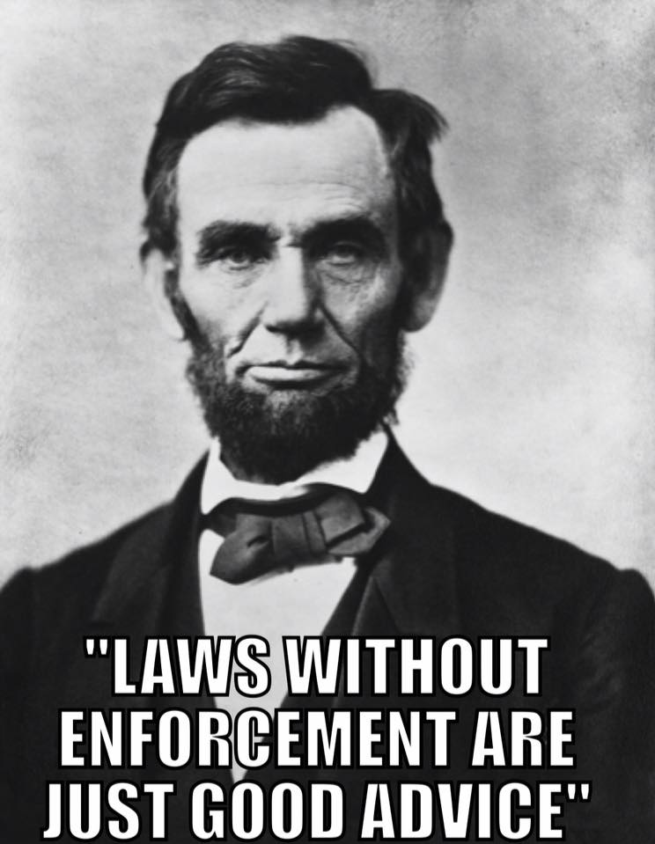

Slide 3

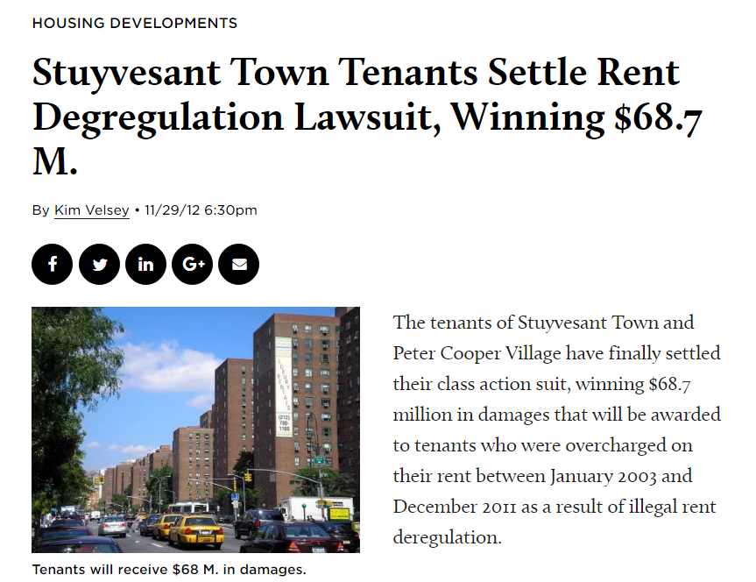
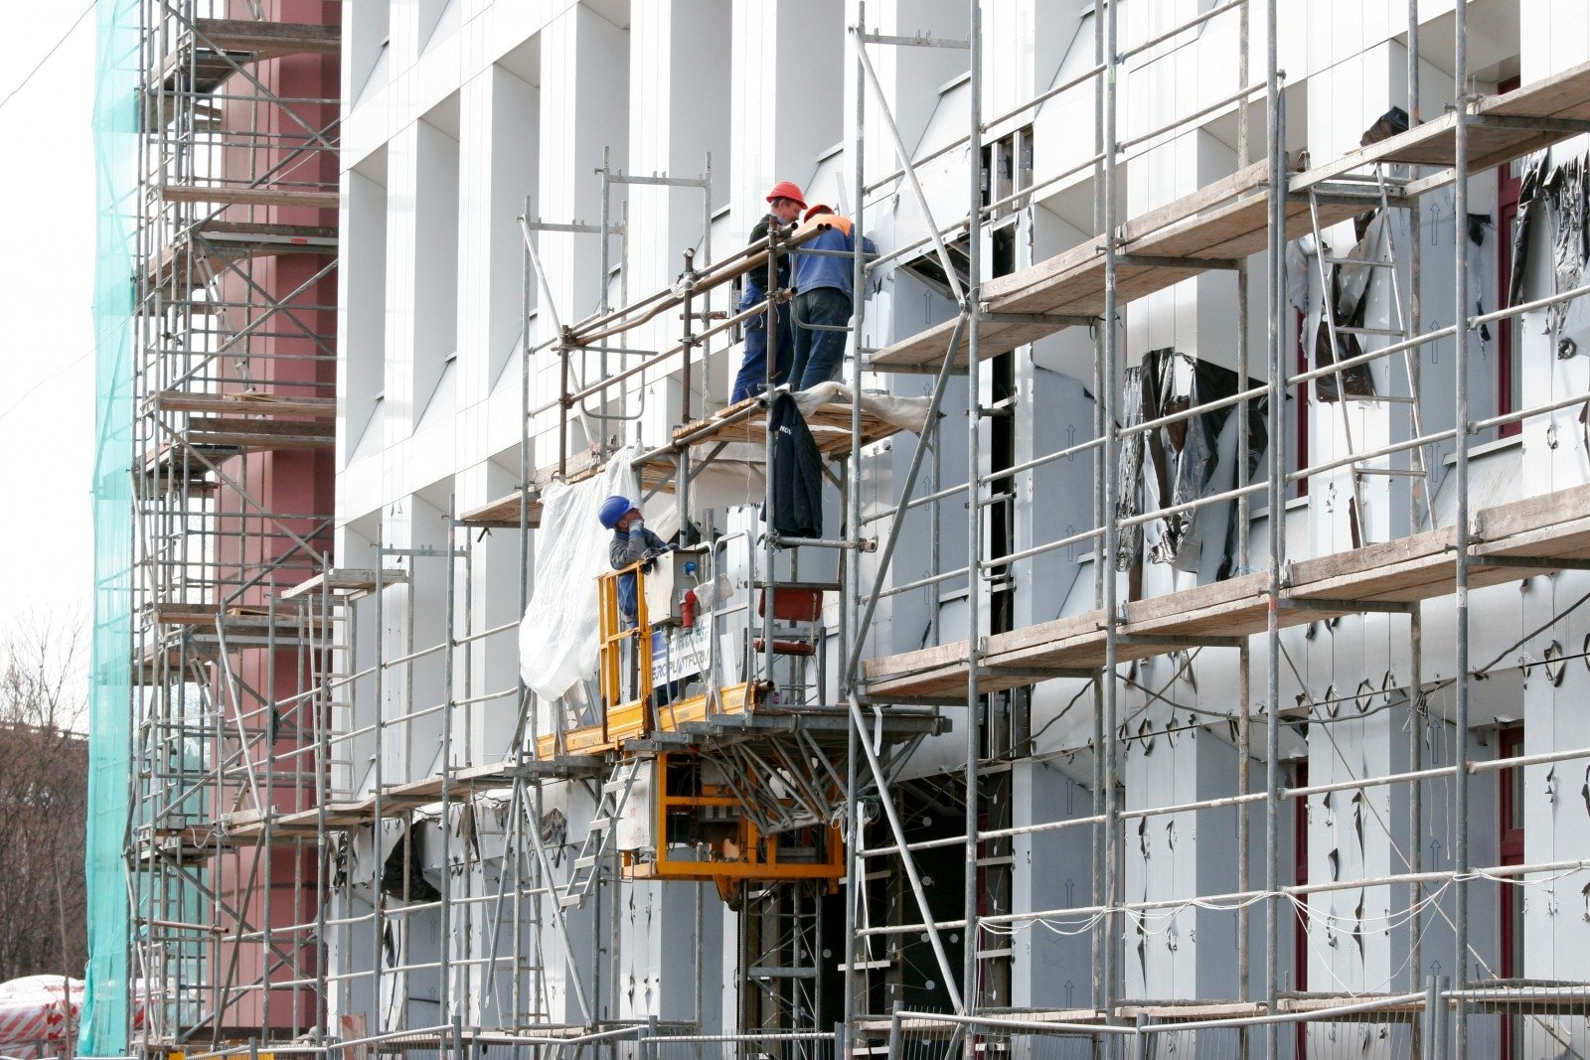
Tax Program: $250 Million a Year

Slide 4
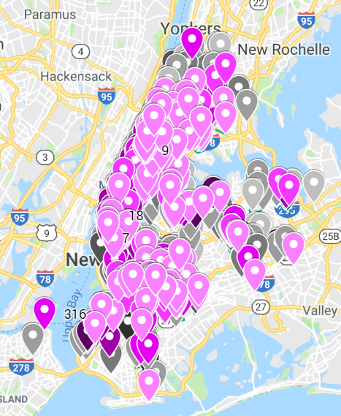
Nearly 8 years later…

Slide 5
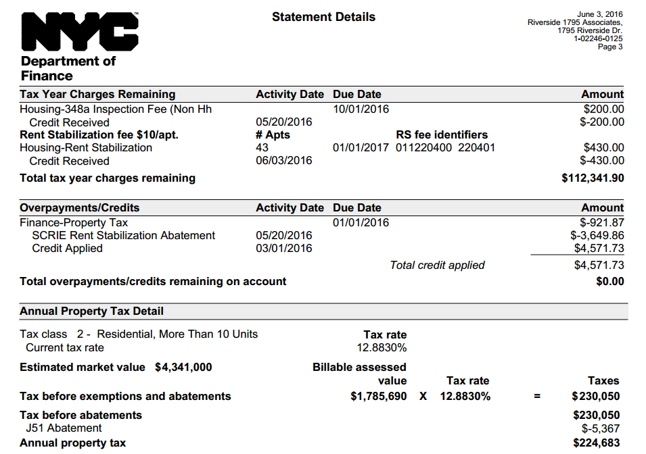
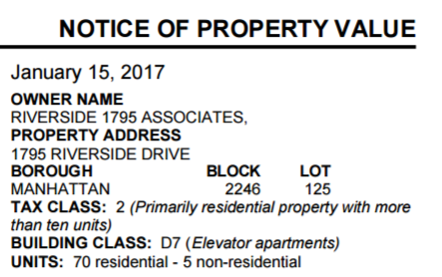
How to Identify J-51 fraud
Search: “NYC property select” in Google

Slide 6
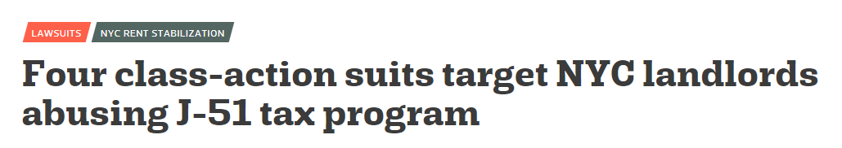
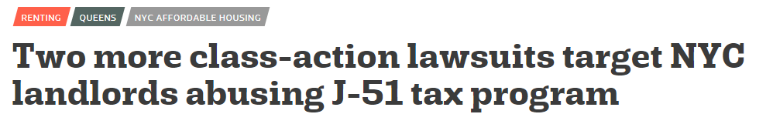
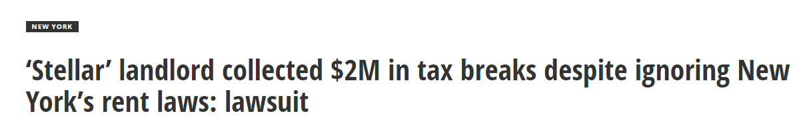
HRI has organized over 40 J-51 class actions

Slide 7

Discussion: What can the City/State do about the longstanding problem of J-51 fraud and tax benefit fraud?

Slide 8
Individual Apartment Improvements

Slide 9








Individual Apartment Improvement Fraud
Individual Apartment Improvements

Slide 10


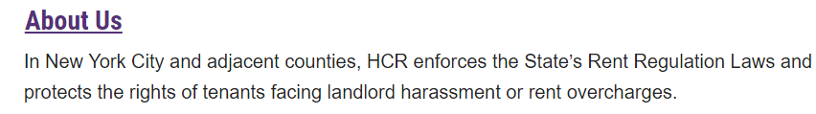
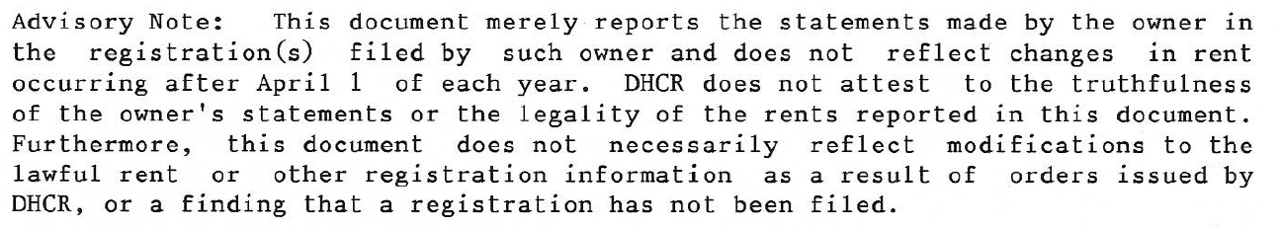
“DHCR does not attest to the truthfulness
of the owner’s statements or the legality of the rents reported in this document.”

Slide 11


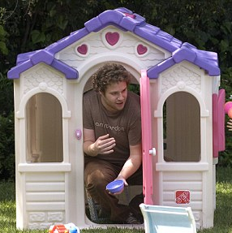
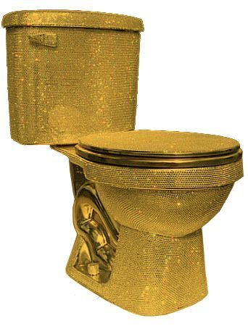


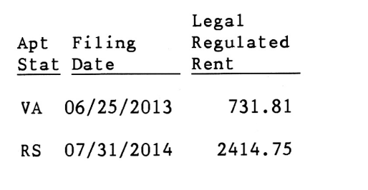
Example rental history
~$100,000 individual apartment improvement claim

Slide 12


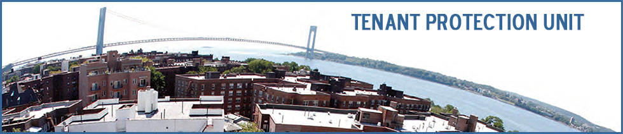
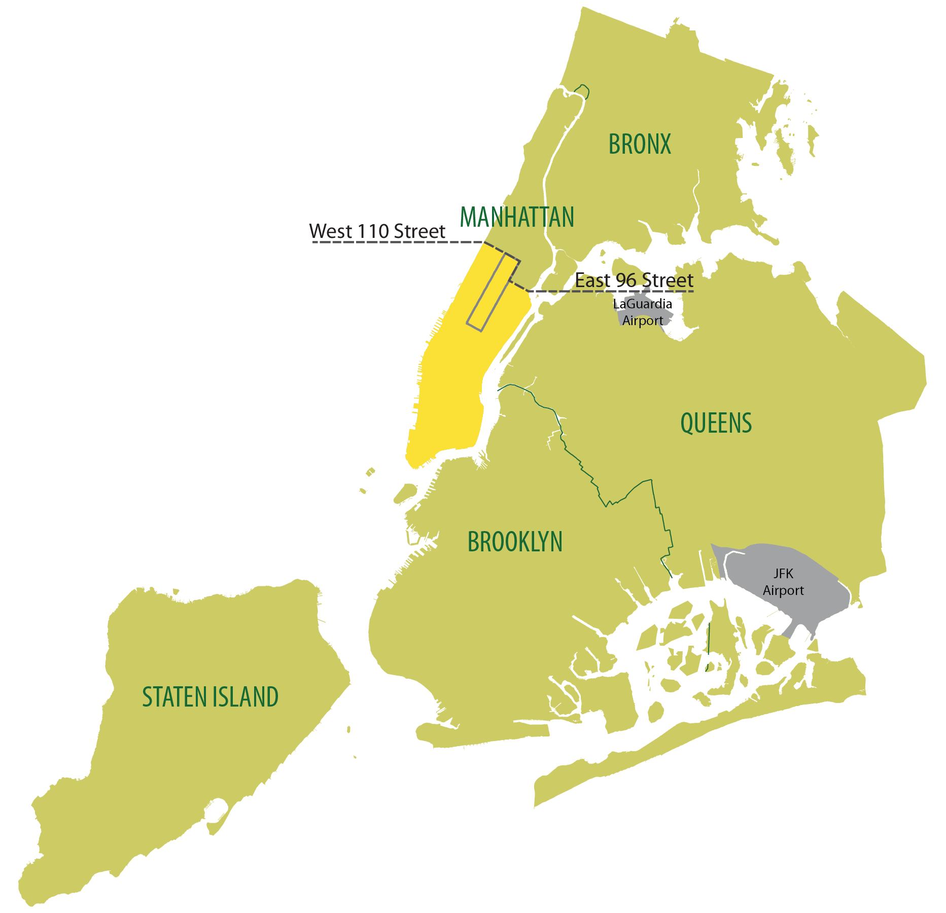
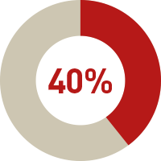
New York State Audit

Slide 13
Discussion: What can the City/State do about Individual Apartment Improvement fraud?

Slide 14
Major Capital Improvements (MCIs)

Slide 15
Major Capital Improvements
Building-wide improvements
Permanently increases the rents of rent stabilized units by up to 6% a year until the entire cost is paid off.

Slide 16


Slide 17

















Proof of Payment
Actual Cost:
j
j
Approved amount:
j
$500,000
$100,000
Inflated/ returned:
$500,000
j
$400,000
Shell Construction Company #1
$2700
$2500
$2300
$2100
$1900
$1700
$1500
$1300
$1100
$900
$700
Unit A
Unit B
Unit C

